Slide 1
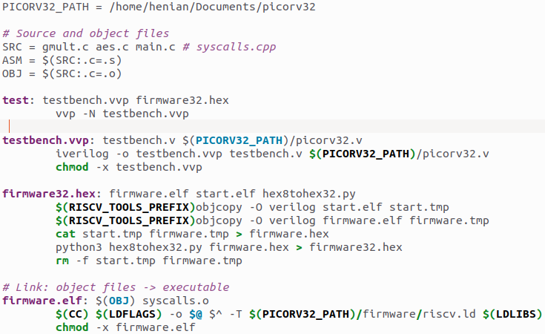
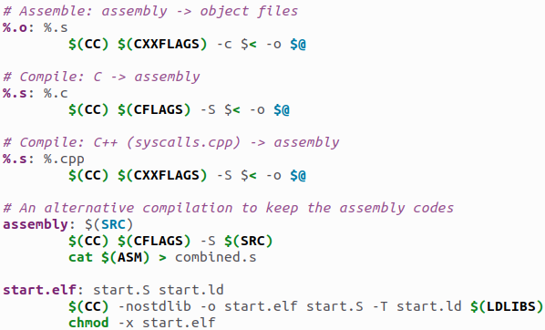
GCC-RISCV Compilation
Flow automated in Makefile
Finally built the PicoRV32 core
Simulated assembly instructions on PicoRV32
Built the GCC-riscv compiler tool chain
Now this flow fully support taking any source code input, compile, and co-simulate with hardware at RTL
Compile – Assemble – Link process
Compile: software -> assembly
Assemble: assembly -> binary
To turn .S to machine code specifically for PicoRV32, we need to allocate the address of instr. mem, reg. file, etc.
Link: binary -> executable
GCC-riscv will link to Newlib, which does not have a static entry point of program (not supported by PicoRV32)
Addressed this issue.
ELF is a cross-platform binary format supporting many CPUs or ISAs
Add a flag here to turn on any build-in or customized hardening technique, e.g.:
-fplugin=./security_plugin.so
start.S initiates registers and the stack

Slide 2
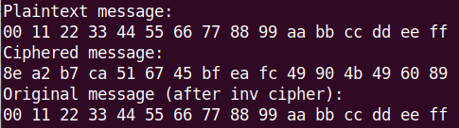
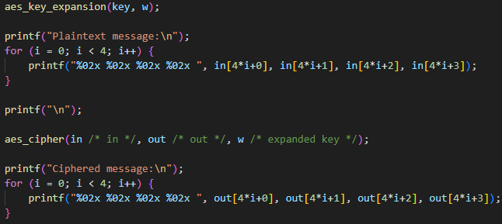
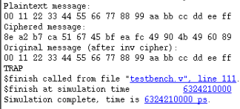
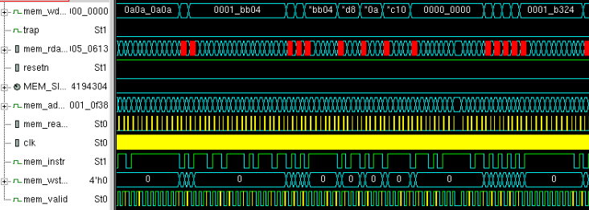

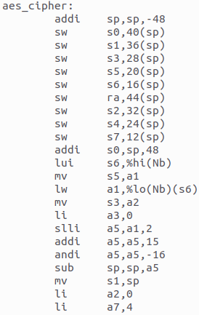
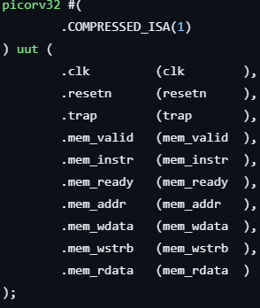

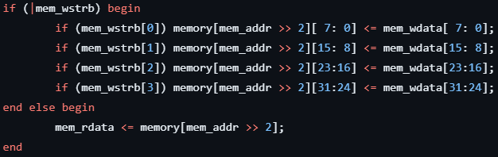
Simulation Results from AES Software
Using a popular AES implementation in C from Github
Simply run the compiled executable
compile
aes.elf or
aes.exe
RTL simulation in VCS
Add start.elf, and convert all to .hex

Slide 3

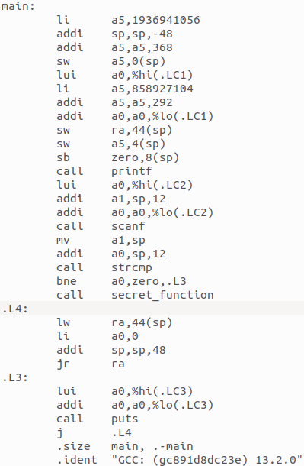
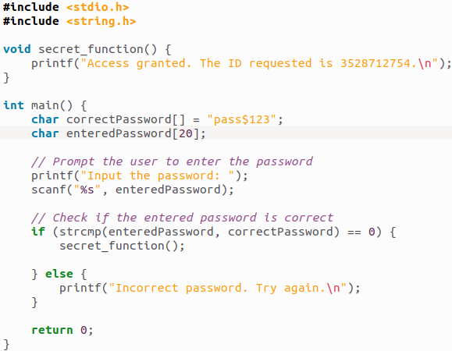
Hardening Compilation
However, even this simple AES has 66,797 lines of assembly instructions (in RISC-V)
Learning GDB (GNU debugger)’s code tracking feature to get a C-assembly mapping
A simpler testcase: password authentication
Call secret function under the correct key input
What if “bne a0, zero, .L3” is skipped?
compile

Slide 4
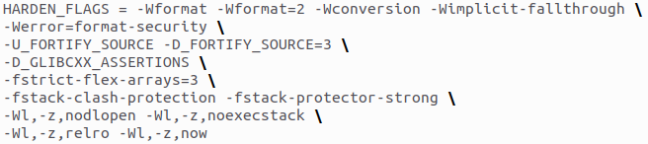
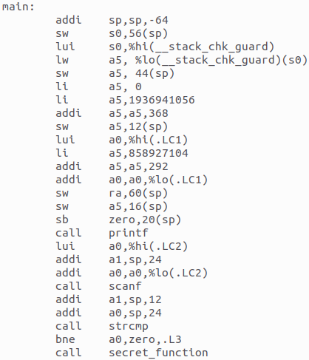
Hardening Compilation
Built-in GCC hardening flags did not solve this.
Canary-based stack overflow protection is added
harden
Same vulnerability here

Slide 5
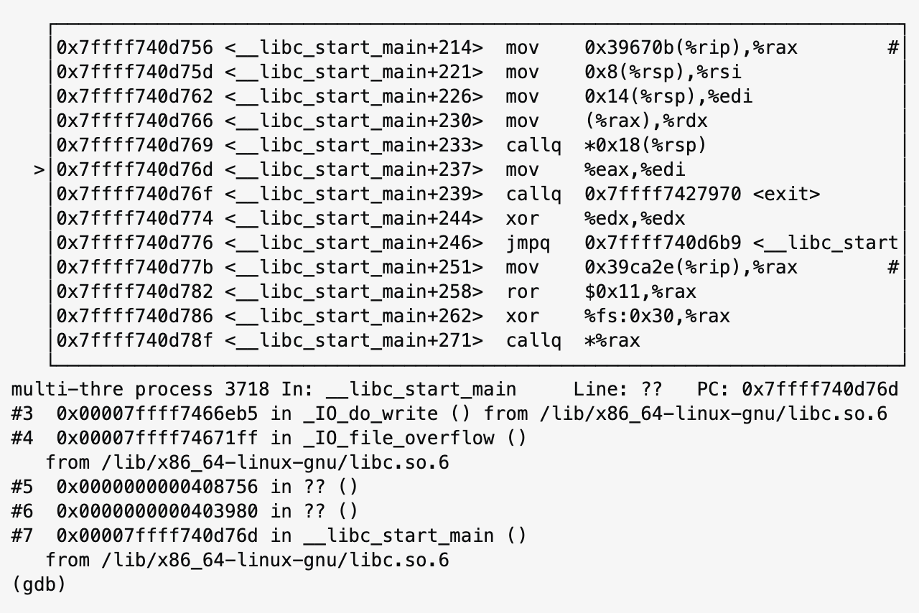
Locate Critical Assembly Code Snippets
Given several lines of critical C/C++, how do we determine
What part of assembly codes are generated from them?
When are these assembly instructions executed in hardware
What hardware resources these instructions are using? -> can be done by checking switching activities during a certain time window (still need to know the window first)
GDB built in riscv-gcc cross compiler does not come with this feature
The gcc-riscv cross compiler should be re-built with “—enable -tui” flag to support
Looking for the possibility to install this library
On the other hand, micro-architecture level fault simulators might have solved this issue
An example of using GDB debugger to locate specific assembly instructions

Slide 6
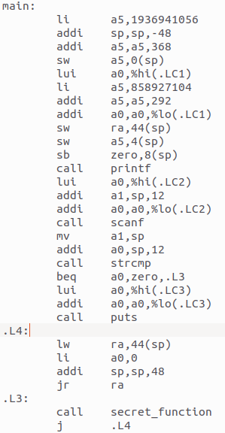
A Simple Example of Hardened Code
We can now compile any C/C++ code for RISC-V, and simulate in RTL with PicoRV32 core
Next
Improve, automate, and add this feature into GCC plug-in
To verify the effectiveness of this hardening, first, we need to find the exact cycle(s) when executing specific instruction lines in RTL simulation
harden
What if “beq a0, zero, .L3” is skipped? Still safe.

